Slide 1

Application Delivery Fundamentals 2.0 B: Java
Parameswari Ettiappan

Slide 2
JMeter Goals
Introduction
Running Jmeter
Introduction to Elements of JMeter Test Plan
Building a Test Plan
Adding Users
Recording Tests Using Jmeter
Handling the dynamic server values
Parameterize with test data

Slide 3
JMeter Goals
Adding Assertions to the test script
Building a Monitor Test Plan
Running Multiple Scripts with Jmeter
Reporting and Analyzing the Results
Best Practices

Slide 4
Why Performance Testing
Performance testing is the testing performed on a system or application to measure some of its attributes such as response time, throughput, scalability, etc.
These attributes are called the performance criteria.
There are many types of performance tests, each of which requires different performance criteria to be measured.
Depending on the nature of the application, some of the performance criteria may be more important than others.
Performance testing is different than functional testing.
In performance testing, we are primarily focused on speed, whereas functional testing is concerned with correctness of the application behavior.
Although performance tests are a part of the continuous build cycle along with the functional tests, the results of performance testing should be interpreted only after the application passes the functional tests.

Slide 5
Response Time
The time taken by the application to respond to the user’s request is called the response time.
It is measured in seconds or milliseconds as appropriate for the application.
Every application should strive to minimize the response time.

Slide 6
Response Time
Absolute Response Time: This is the total time taken from the instant a user clicks on a link or submits a form until the response from the server is rendered completely.
Server Processing Time: This is the time taken by the server to process the given input and generate the output. This can vary depending on the complexity of the request, server hardware, and the system load.

Slide 7
Response Time
Rendering Time: This is the time taken by the browser to parse and render the response received from the server.
This depends on the complexity of the web page, presence of multimedia, presence of JavaScript, and whether the browser needs to generate content.
It also depends on the system load on the user’s device.

Slide 8
Response Time
Network Latency: This is the round-trip time taken by a data packet to travel over the network the server and back.
This does not include the server processing time or the rendering time.
This can vary widely depending on the location of the user, time of the day, and the network load.

Slide 9
Throughput
A sequence of request/responses constitutes a transaction.
The number of transactions per unit time is called the throughput.
It is measured in transactions/second or bandwidth (bytes/second).
It depends on server hardware, system load, and network latency.
The application should strive to maximize the throughput.

Slide 10
Utilization
Utilization is the ratio of the throughput of the application relative to its maximum capacity.
This is a measure of how well the application is being used.
It is not desirable to operate above 80% utilization because the user requests do not arrive evenly, and the system should be able to handle a spike in the load.

Slide 11
Robustness
This is a measure of how well the application detects and handles various errors and exceptions.
If the system crashes or becomes unavailable, the company’s brand and reputation are at stake.
Mean Time between Failures (MTbF) is a metric that is often used for this purpose.

Slide 12
Scalability
Scalability measures how well the system can expand its capacity when additional resources are added.
Ideally the system capacity will increase linearly as additional resources are added.
However, this is rarely achieved in practice. It’s a good measure to know the resources that would be needed so that the system can handle the projected future load.
Vertical scalability is achieved by upgrading the hardware. For example, by adding more memory, disk, a better CPU, or additional CPUs.
Horizontal scalability is achieved by adding servers to the cluster. For example, by adding more web servers and application servers to a webfarm/cluster.

Slide 13
Performance Test Types
Stress Tests
A stress test is a kind of performance test that tests the application beyond the normal limits.
The application is subjected to excess load and after that its stability and performance are noted.
This type of test is used to determine how the application responds to load spikes.

Slide 14
Performance Test Types
Load Tests
A load test is a kind of performance test that’s performed at the specified load level.
So ideally, we would like to perform load tests at varying load levels to note the behavior of the application.

Slide 15
Performance Test Types
Peak Load Tests
A peak load test is performed at the load that the application is expected to handle. For example, e-commerce web sites experience their peak traffic during Black Friday, Cyber Monday, and the Christmas holidays.
So a peak load test in this case would test the application within the load specification but at the higher end.

Slide 16
Performance Test Types
Soak Tests or Endurance Tests
In a soak test (also called an endurance test), the application is subjected to a specified load that is within the specified limit but for a long duration.
It is performed for many hours at a time.
This test determines if the application is properly reusing its resources.
This test will surface problems like the following:
• Memory leaks in the application
• Database connections exhaustion
• Network connection exhaustion
• Log files becoming full and log rotation
• Other resource exhaustion

Slide 17
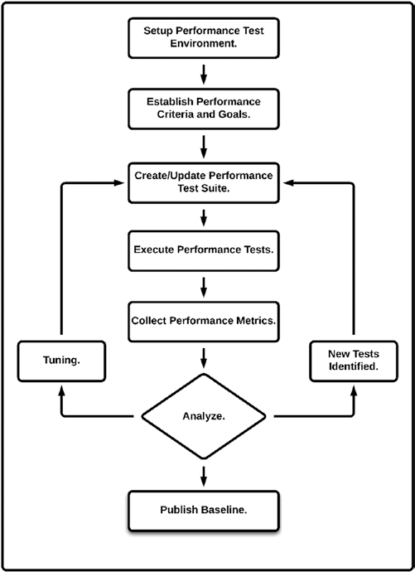
Performance Tuning

Slide 18
JMeter
JMeter is a desktop application, designed to test and measure the performance and Functional behavior of client/server applications, such as web applications or FTP applications.
It is one of the most widely used open-source, freely distributed testing application that the Net can offer.
It is purely Java-based and is highly extensible through a provided API (Application Programming Interface).
JMeter works by acting as the "client side" of a "client/server" application.
It measures response time and all other server resources such as CPU loads, memory usage, and resource usage.

Slide 19
JMeter
JMeter can be used effectively for functional test automation.
In addition, it has tools that support regression testing of similar types of applications.
It was originally designed for testing web applications,
It has been extended to support other test functions.
It was first and still is being developed as one of the Apache Jakarta Projects (http://jakarta.apache.org), as this project offer a diverse set of open-source Java solutions.
JMeter was first developed by Stefano Mazzocchi of the Apache Software Foundation.

Slide 20
JMeter
He wrote it primarily to test the performance of Apache JServ,which was later replaced by the Apache Tomcat Project.
JMeter has since been developed and has expanded to load-test FTP servers, database servers, and Java Servlets and objects.
Today, it has been widely accepted as a performance testing tool for web applications.

Slide 21
What JMeter Can Do for You
Performance testing of HTTP and FTP servers, and database queries
100% Java-based, hence has features that any Java application has:
Portability: can run on any JVMs
Concurrency: by many threads and of different functions by separate thread groups
Extensible:
– Unlimited testing capabilities—various samplers can be used
– Pluggable timers allow simulation of various types of loads
– API and/or plug-ins allow great extendibility as well as customization
– Built-in functions can be used to provide dynamic input to a test
– Scriptable Samplers
Efficient GUI (Java Swing) design and lightweight component support allows faster execution and more accurate timings Caching of test results and data providing offline analysis/replaying of test results

Slide 22
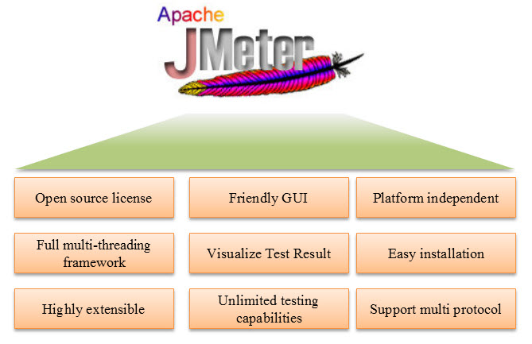
Advantages

Slide 23
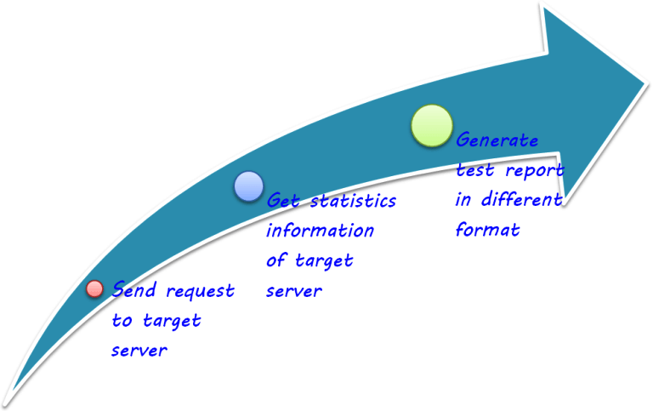
How does JMeter work ?

Slide 24
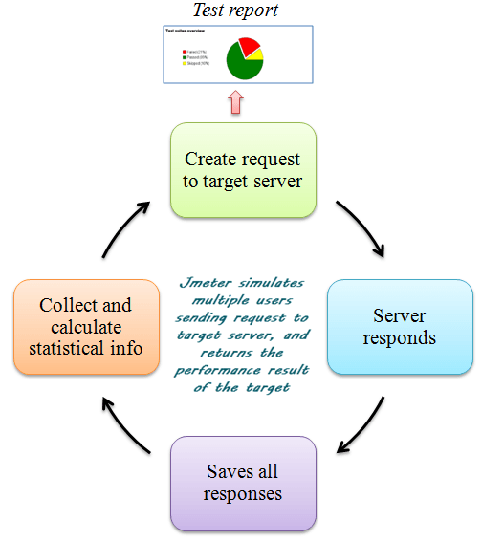
How does JMeter work ?

Slide 25
The Look-How-Easy-to-Use GUI
A typical test plan will consist of one or more Thread Groups, logic controllers, listeners, timers, assertions, and configuration elements:
Thread Group—each thread simulates a single user. All elements of a test plan must be under a thread group.
Listeners—Provide access to the information gathered by JMeter about the test cases while JMeter runs.
Controllers—Samplers tell JMeter to send requests to a server, while Logical Controllers let you customize its logic.
Timers—Allow JMeter to delay between each request that a thread makes.
Assertions—Allow you to "test" that your application is returning the results you expect it to.
Configuration Elements—Working closely with a Sampler, these can add to or modify requests.

Slide 26
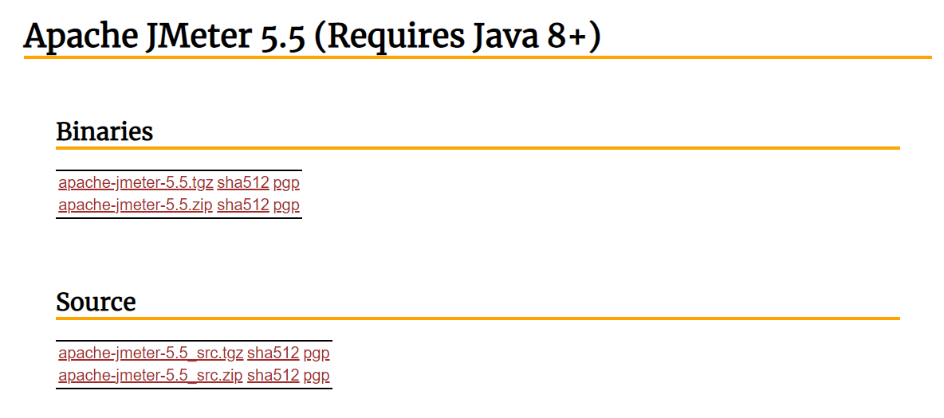
Download Jmeter

Slide 27
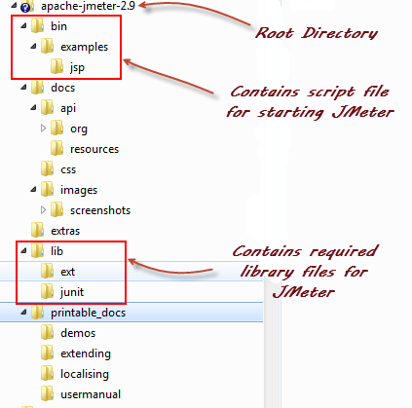
Installation

Slide 28
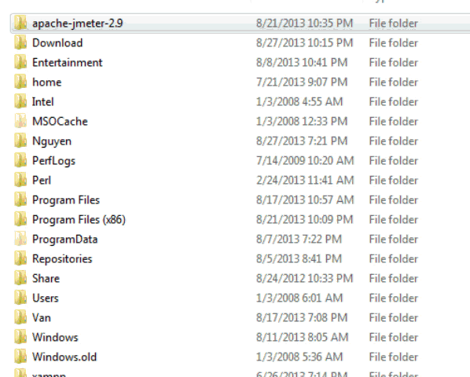
Start JMeter in GUI Mode

Slide 29
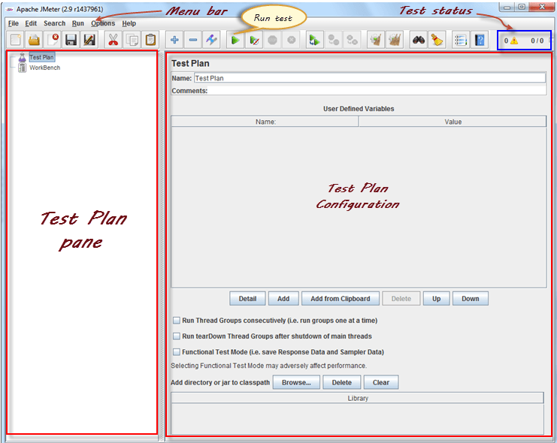
Start JMeter in GUI Mode

Slide 30
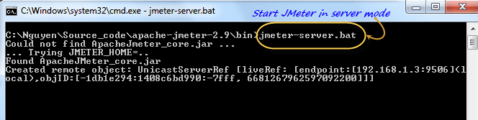
Start JMeter in Server Mode

Slide 31
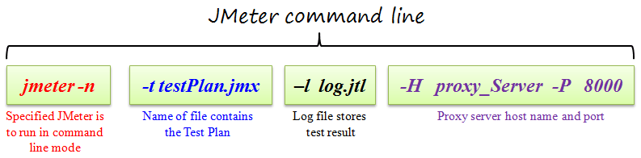
Start JMeter in command line mode

Slide 32
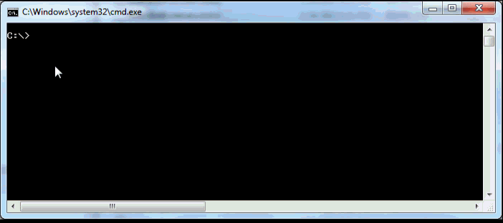
Start JMeter in command line mode
jmeter -n -t testPlan.jmx - l log.jtl -H 127.0.0.1 -P 8000

Slide 33
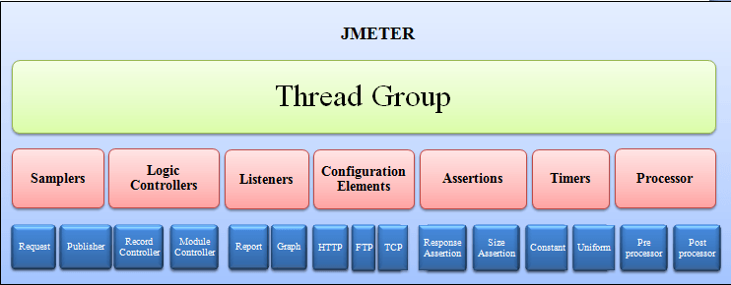
Components of a JMeter Test

Slide 34
Test Plan
The test plan is the top-most element and is the root of the tree.
For a test plan, the name, description, and user variables can be configured.
A Test Plan defines and provides a layout of how and what to test: the web application as well as the client server application.
It can be viewed as a container for running tests.
It provides a framework in which it will execute a sequence of operations or tools to perform the testing.
A test plan includes elements such as thread groups, logic controllers, sample-generating controllers, listeners, timers, assertions, and configuration elements.
A test plan must have at least one thread group.

Slide 35
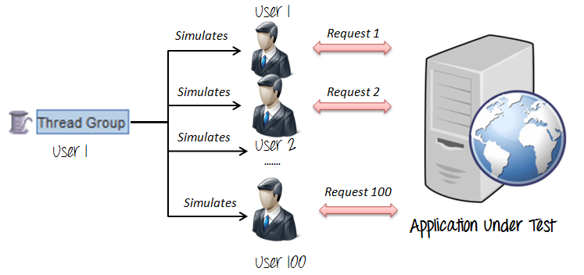
Thread Group
Every test has one or more thread groups.
A thread group is a child element of a test plan.
Each thread group represents a use-case.
A thread group can be configured with the number of threads, ramp-up time, and other useful properties that allow you to control its behavior.

Slide 36
Controllers
Each thread group has one or more controller elements.
Logical controllers decide the flow of execution.
They determine the next Sampler to execute.
JMeter comes with many built-in logical controllers that provide precise control flow.
For example, the If controller and Switch controller provide branching; the ForEach, While, and For provide iteration flow.
There is a controller for every programming construct.
A custom controller, if needed, could be developed using the plugin API mechanism provided by JMeter.

Slide 37
Controllers
JMeter has two types of Controllers:
1. Samplers:
These allow JMeter to send specific types of requests to a server.
We will be sending HTTP Requests the most, so we will use HTTP Request Sampler to let JMeter send those requests.
We may add Configuration Elements to these Samplers to customize your server requests.
2. Logic Controllers:
These allow us to customize the logic that JMeter uses to decide when to send requests. For example, we can use Random Controllers to send HTTP requests to the server randomly.

Slide 38
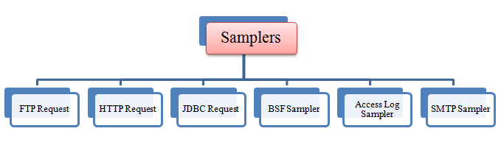
Samplers
Sampler is a child element of a thread group or a controller.
It sends requests to the server. For every protocol, we need a separate sampler.
Out of the box, JMeter comes with many samplers. For example, to send a HTTP request, we use a HTTP Request Sampler.
Custom samplers can be developed using the JMeter plugin mechanism.

Slide 39

FTP request

Slide 40
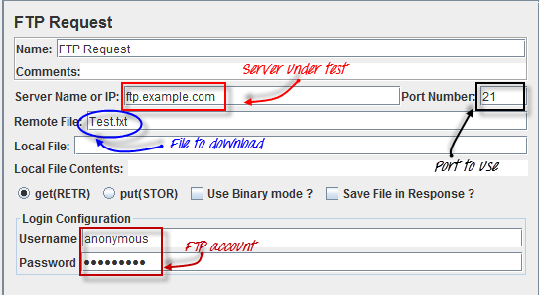
FTP request

Slide 41

HTTP request

Slide 42

JDBC request

Slide 43
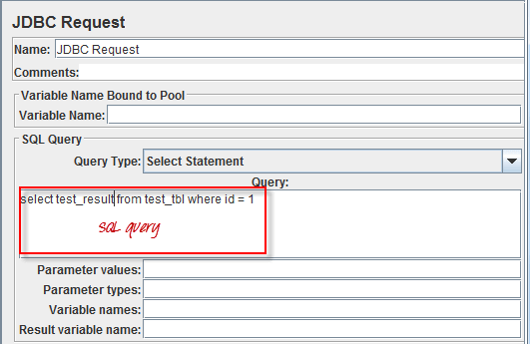
JDBC request

Slide 44
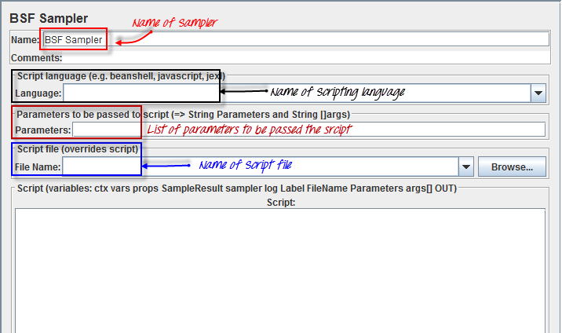
BSF Sampler:

Slide 45
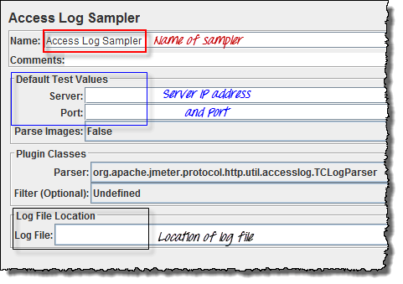
Access Log Sampler

Slide 46
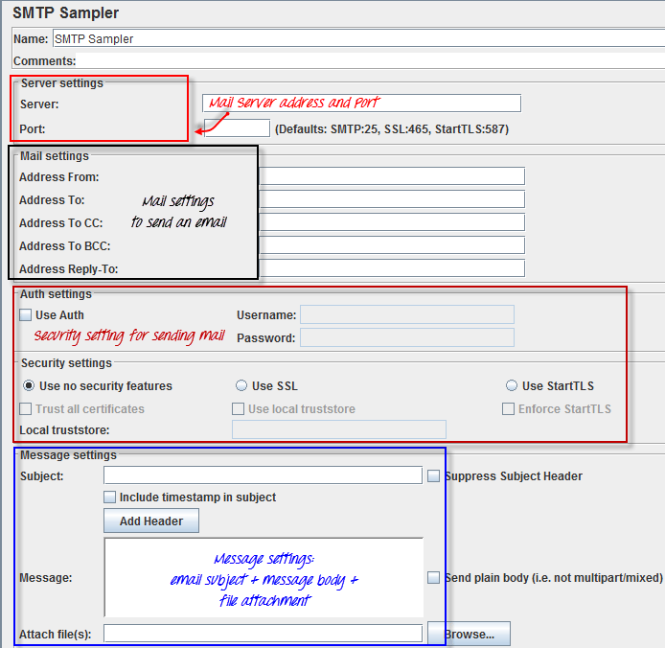
SMTP Sampler

Slide 47
Logic Controller
Logic Controllers let us define the order of processing Samplers in a Thread, as wecustomize the logic that JMeter uses to send requests.
A Logic Controller changes the order of requests that come from its sub-elements, or child elements.
The child elements of a Logic Controller may comprise Samplers, Configuration Elements, and more Logic Controllers.
For these requests, JMeter may randomly select (using Random Controller), repeat (using Loop Controller), interchange (using Interleave Controller) etc

Slide 48
Logic Controllers

Slide 49
Logic Controllers
Simple Controller
Loop Controller
Once Only Controller
Interleave Controller
Random Controller
Random Order Controller
Throughput Controller
Runtime Controller

Slide 50
Logic Controllers
If Controller
While Controller
Switch Controller
ForEach Controller
Module Controller
Include Controller
Transaction Controller
Recording Controller

Slide 51
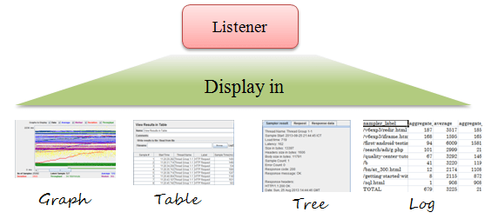
Listeners
Listeners let us view the results of the Samplers in the form of tables, graphs, trees or simple text in some log files.
They provide visual access to the data gathered by JMeter about the test cases as a Sampler component of JMeter is executed.

Slide 52
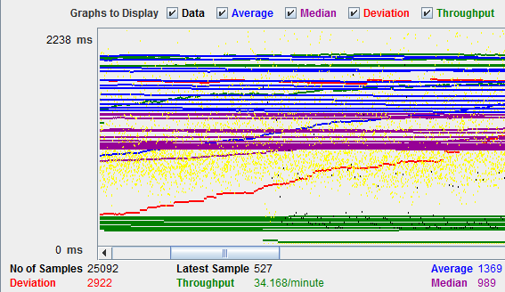
Listeners

Slide 53
List of Listeners
The following list consists of all the Listeners JMeter provides:
Sample Result Save Configuration
Graph Full Results
Graph Results
Spline Visualizer
Assertion Results
View Results Tree
Aggregate Report

Slide 54
List of Listeners
View Results in Table
Simple Data Writer
Monitor Results
Distribution Graph (alpha)
Aggregate Graph
Mailer Visualizer
BeanShell Listener
Summary Report

Slide 55
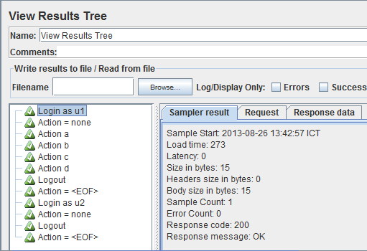
Listeners

Slide 56
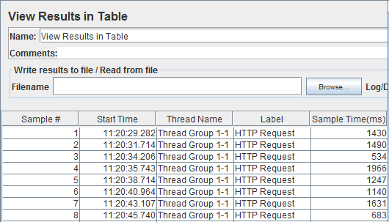
Listeners

Slide 57
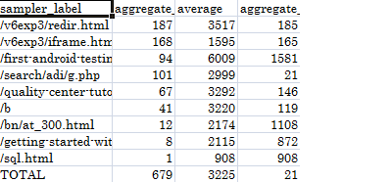
Listeners

Slide 58
Timer
A Timer Component is an option in building a Test Plan.
It causes JMeter to pause for a certain amount of time between two successive requests that a Thread Group makes.
As JMeter, by default, sends one request immediately after the other, which could overwhelm the server, adding a Timer will reduce the risk of breaking down the server's performance.
This is especially useful if you are testing the application from its functional aspect.

Slide 59
List of Timers
Constant Timer
Gaussian Random Timer
Uniform Random Timer
Constant Throughput Timer
Synchronizing Timer
BeanShell Time

Slide 60
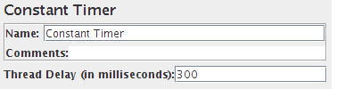
Constant Timer

Slide 61
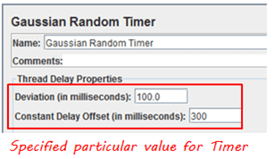
Gaussian Random Timer
Gaussian random timer delays each user request for a random amount of time.

Slide 62
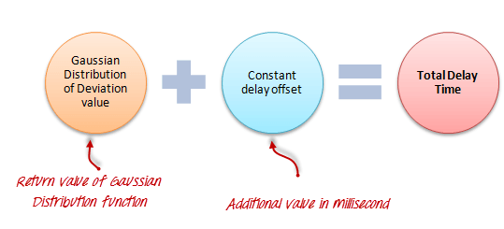
Gaussian Random Timer
Gaussian random timer delays each user request for a random amount of time.

Slide 63
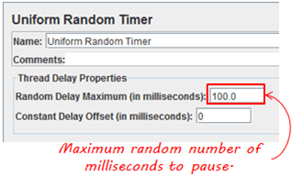
Uniform Random Timer
Uniform random timer delays each user request for a random amount of time.

Slide 64
Assertions
Assertions allow us to include some validation test on the response of your request made using a Sampler.
They are inserted as a child component of a Sampler.
Assertions are particularly necessary in functional testing of your applications, while, in performance testing, we may want to use assertion to ensure the responses we receive.

Slide 65
Assertions
Response Assertion
Duration Assertion
Size Assertion
XML Assertion
BeanShell Assertion
MD5Hex Assertion
HTML Assertion
XPath Assertion
XML Schema Assertion

Slide 66
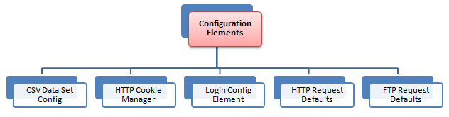
Configuration Elements
Configuration Elements allow us to create defaults and variables to be used by Samplers.
They are used to add or modify requests made by Samplers.
They are executed at the start of the scope of which they are part, before any Samplers that are located in the same scope.
Therefore, a Configuration Element is accessed only from inside the branch where it is placed.

Slide 67
List of Configuration Elements
CSV Data Set Config
FTP Request Defaults
HTTP Authorization Manager
HTTP Cookie Manager
HTTP Proxy Server
HTTP Request Defaults
HTTP Header Manager
Java Request Defaults

Slide 68
List of Configuration Elements
JDBC Connection Configuration
Login Config Element
LDAP Request Defaults
LDAP Extended Request Defaults
TCP Sampler Config
User Defined Variables
Simple Config Element

Slide 69
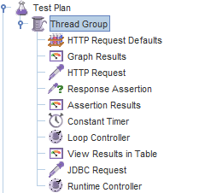
Hands on with JMeter GUI
Test Plan

Slide 70
Building a Test Plan That Tests Web Sites
The elements that we will need for this basic Test Plan are as follows:
Thread Group
HTTP Request (Sampler)
HTTP Request Default (Configuration Element)
Summary Report (Listener)
Things to be done by us are as follows:
Add Users
Add and Configure Default HTTP Request
Add HTTP Requests
Add Listener to View/Store the Test Results
Save & Run Test Plan

Slide 71
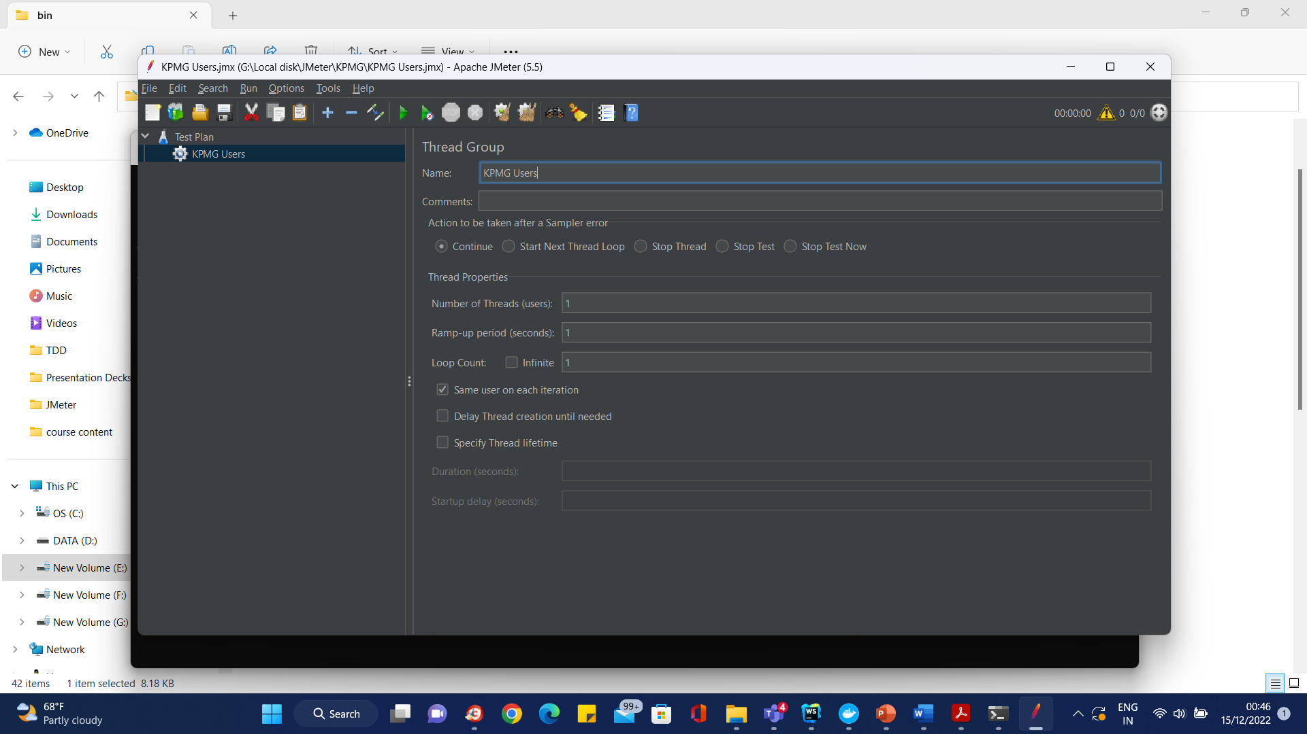
Building a Test Plan That Tests Web Sites

Slide 72
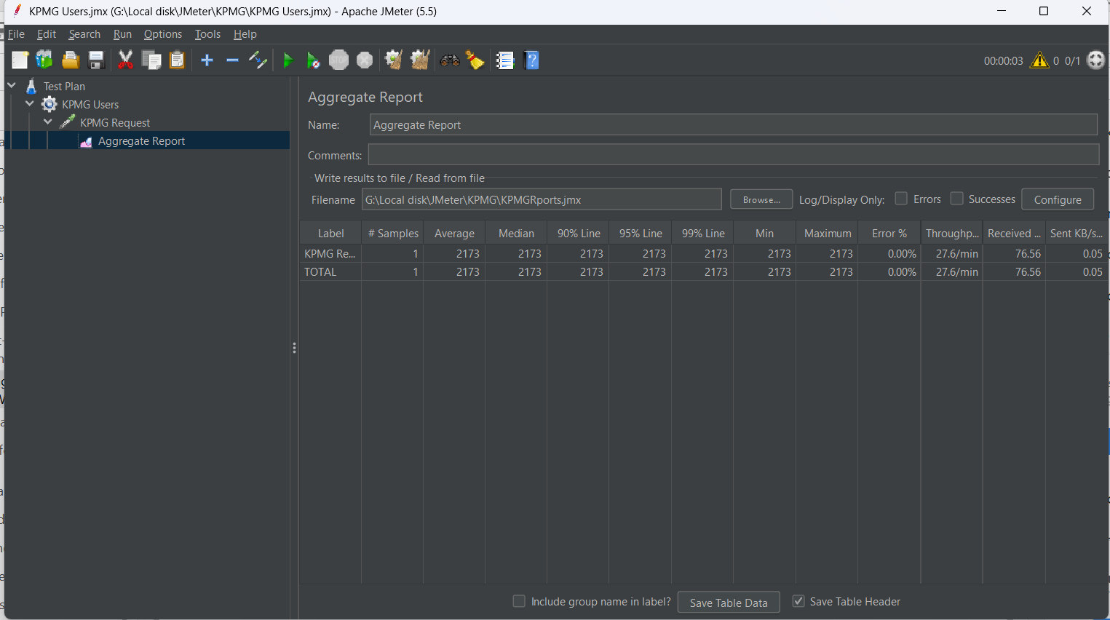
Building a Test Plan That Tests Web Sites

Slide 73
Report Interpretation
Label—The label of the sample
# Samples—The number of samples for the URL
Average—The mean time of a set of results
Median—The time in the middle of a set of results
90% Line—The maximum time taken for the fastest 90% of the samples
Min—The lowest time for the samples
Max—The longest time for the samples
Error %—Percent of requests with errors or failures
Throughput—Throughput measured in requests per unit of time
Kb/sec—The throughput measured in Kilobytes per second

Slide 74
Preparing for Load Testing
Load Testing, being a part of performance testing, is simply the process of subjecting a component or a whole system to a work level approaching its limits.
Load testing is performed within the capacity of the resource(s) being subjected, while stress testing is normally performed to evaluate the performance of resources and behavior at or beyond normal capacity.
In summary, both load testing and stress testing are part of what makes performance testing.

Slide 75
Recording Http Requests
A fast way to capture the HTTP pages of this application is to record every request made to the server.
For this we will need to use a special-purpose Configuration Element: HTTP Proxy Server.
Note that the Proxy Server element is only available in the Workbench element.

Slide 76
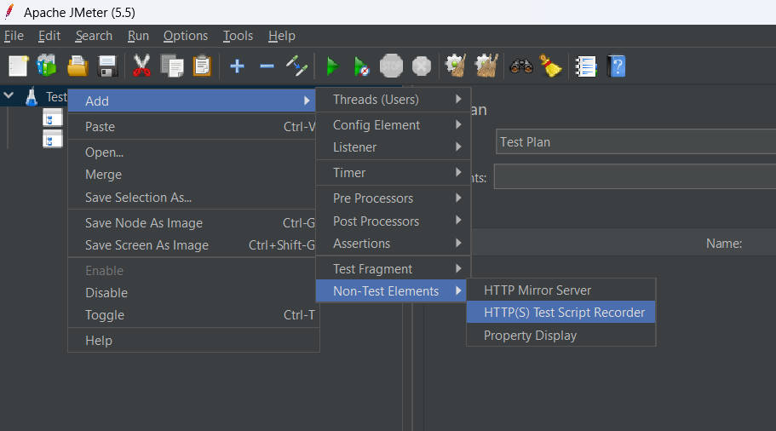
Recording Http Requests

Slide 77
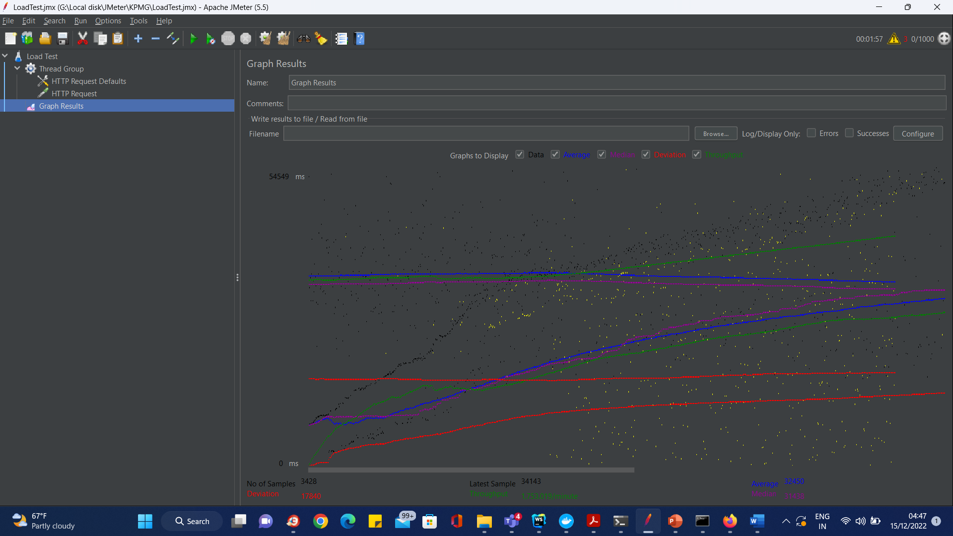
Preparing for Load Testing

Slide 78
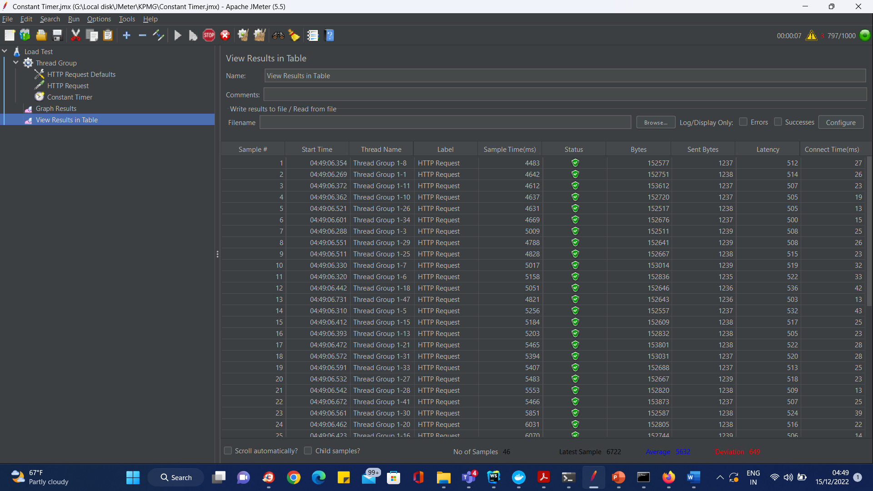
Preparing for Load Testing – Constant timer

Slide 79
Preparing for Load Testing – Constant timer
For example, in the above figure, let analyze the Sample 2
Start time is 22:05:01.866
Sample Time of Sample 2 is 172 ms
Constant Timer: 5000 ms (as configured)
End Time of this sample is = 22:05:01.866 + 172 + 5000 = 22:05:07.038

Slide 80
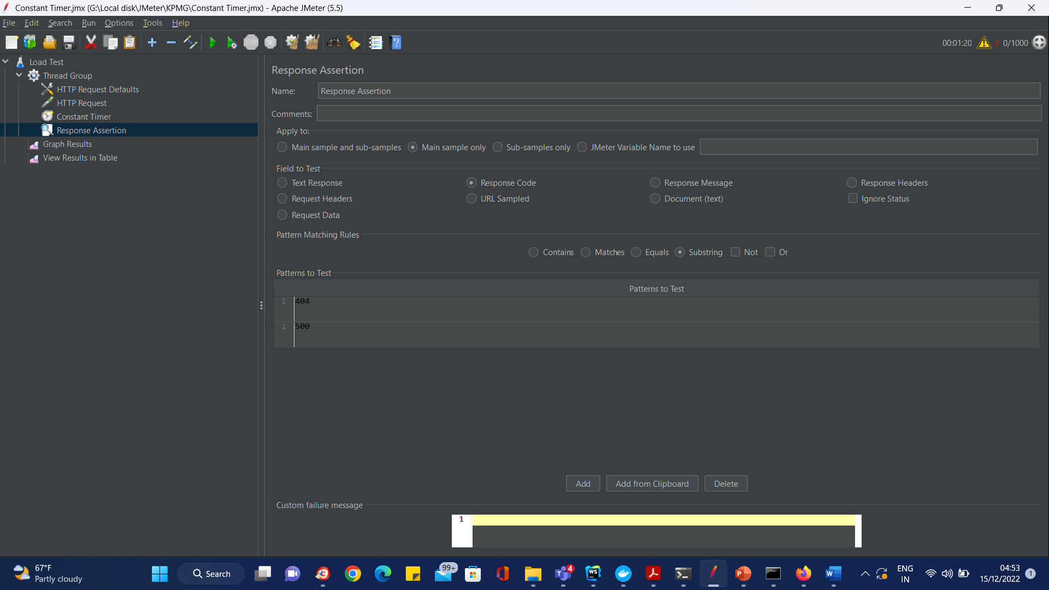
Response Assertion

Slide 81
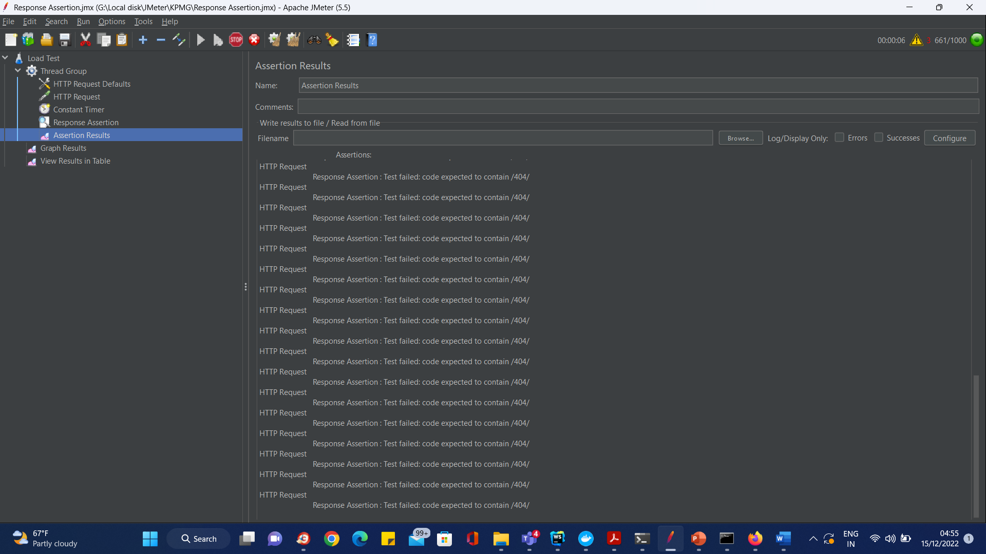
Response Assertion

Slide 82
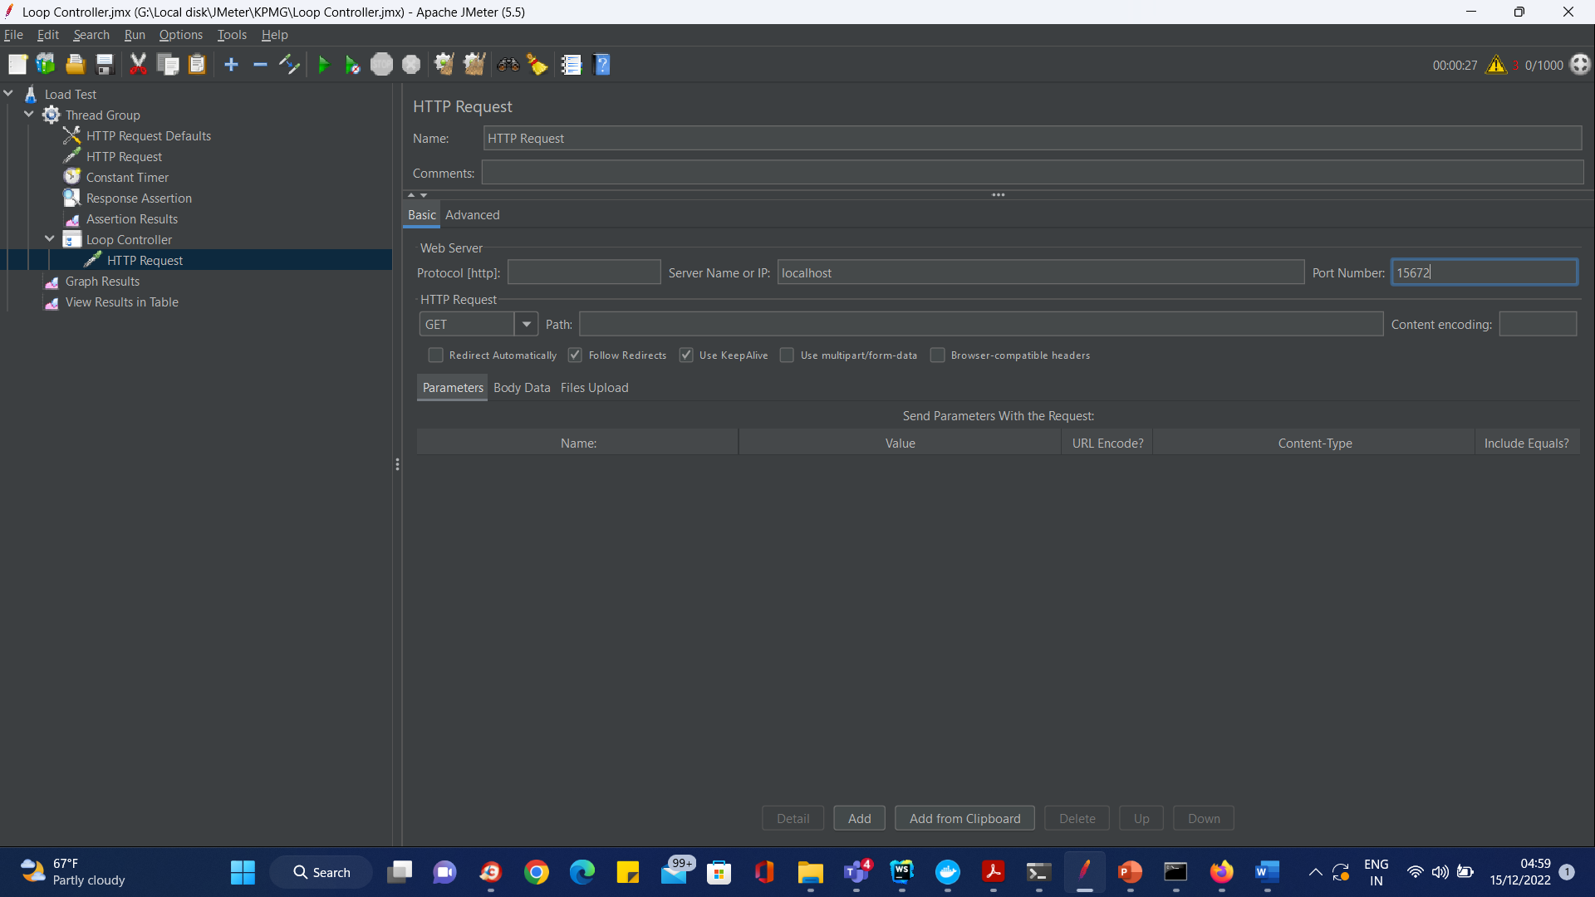
Loop Controller

Slide 83
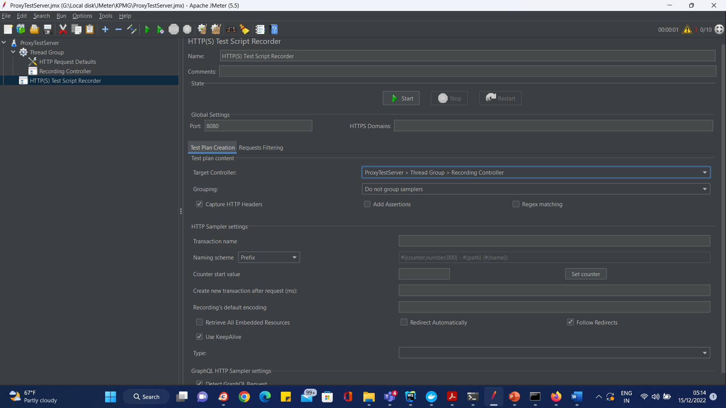
Proxy Server

Slide 84
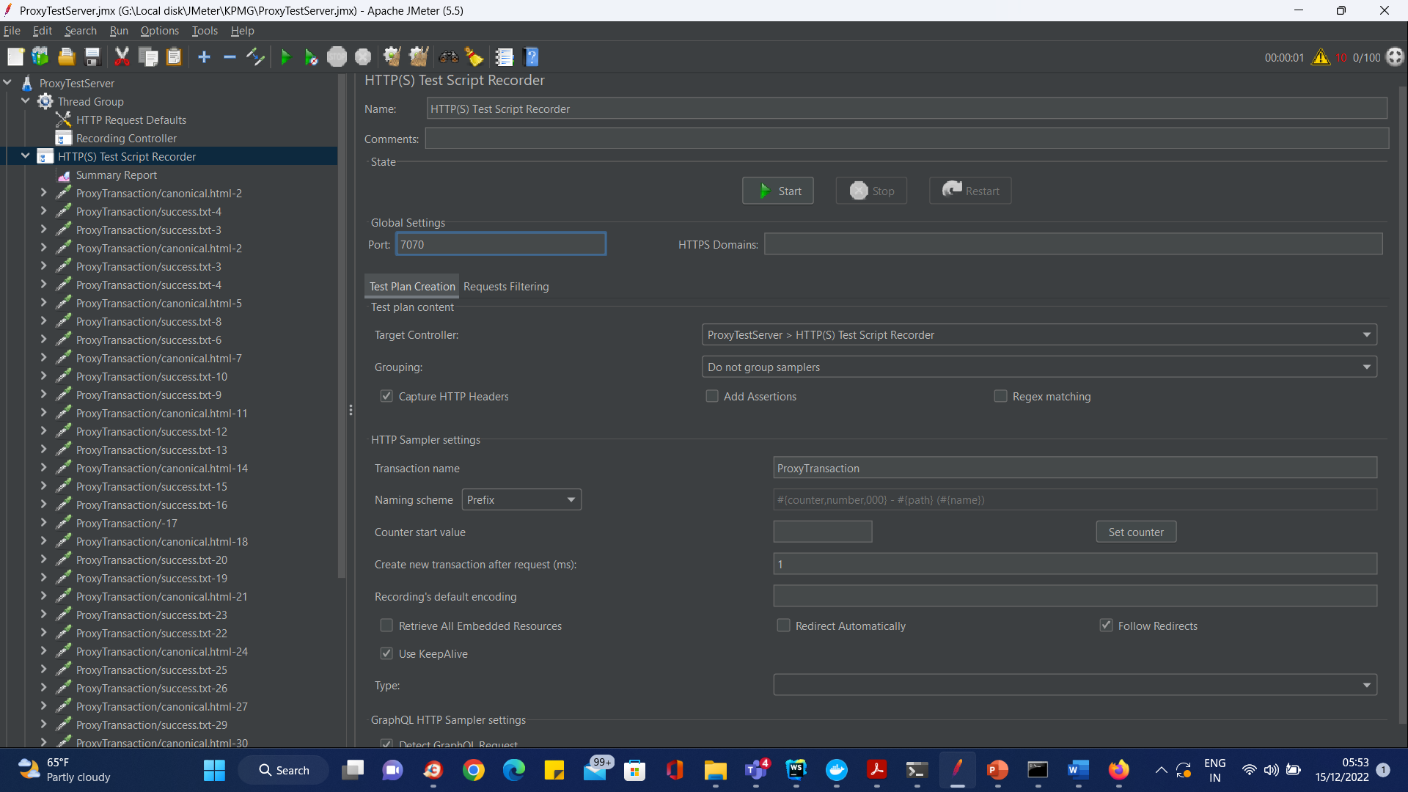
Proxy Server

Slide 85
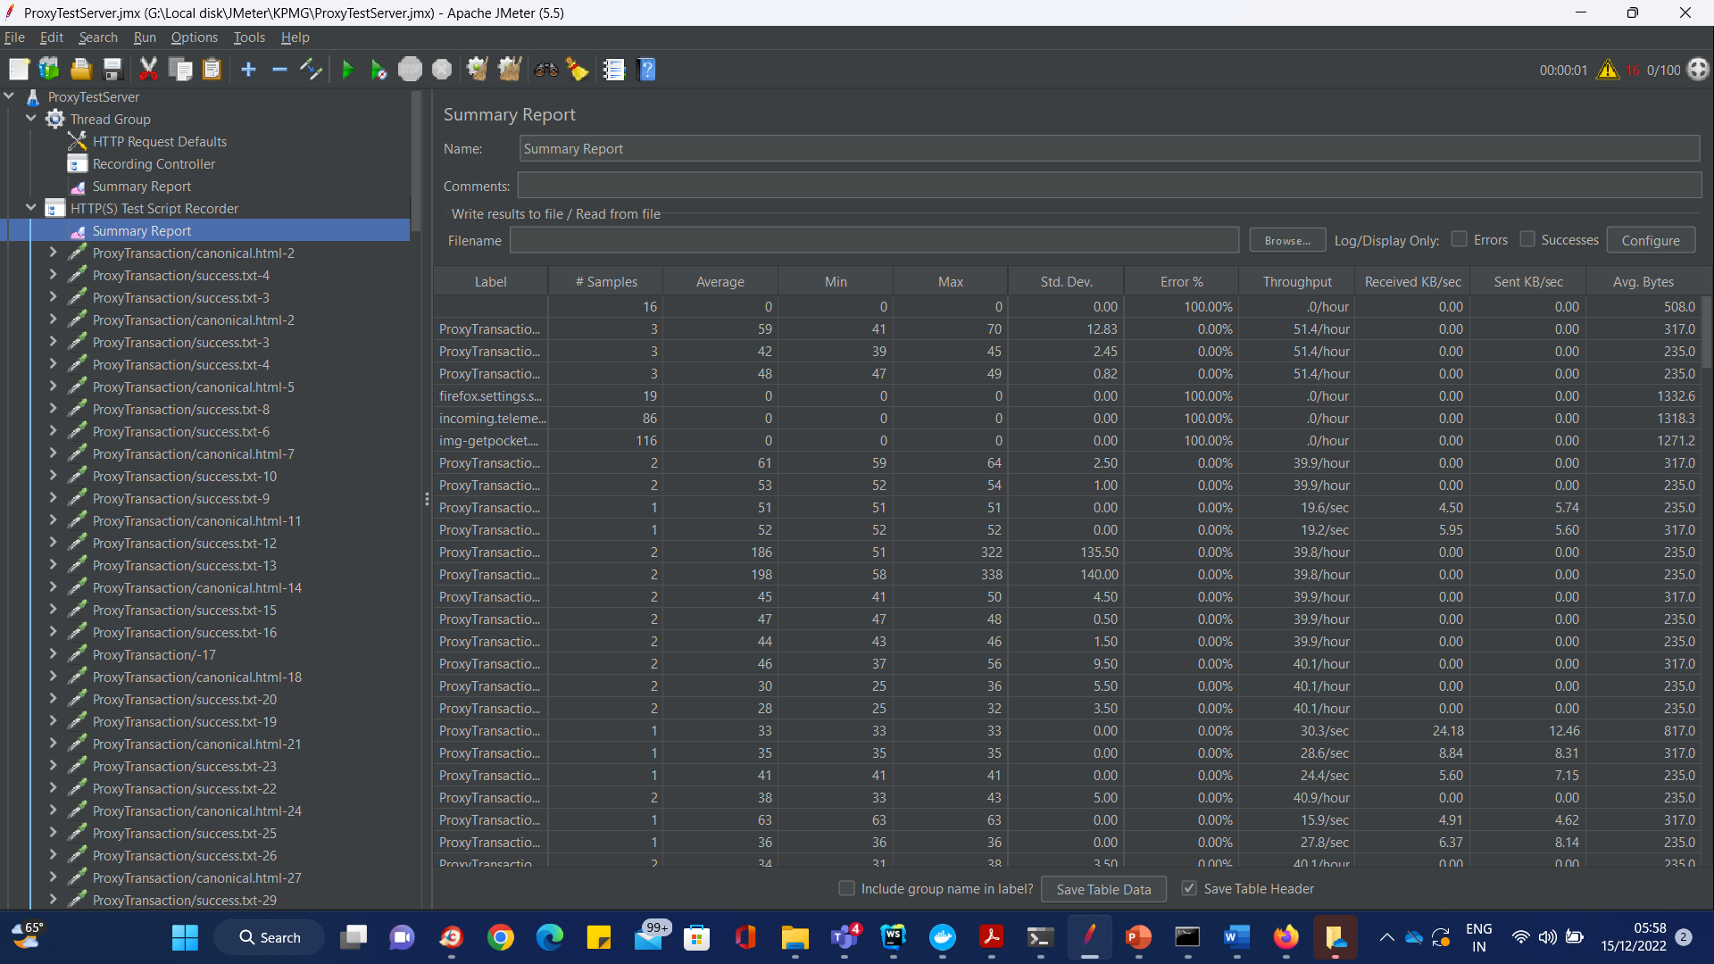
Proxy Server

Slide 86
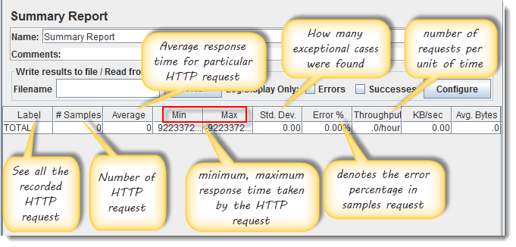
Proxy Server

Slide 87
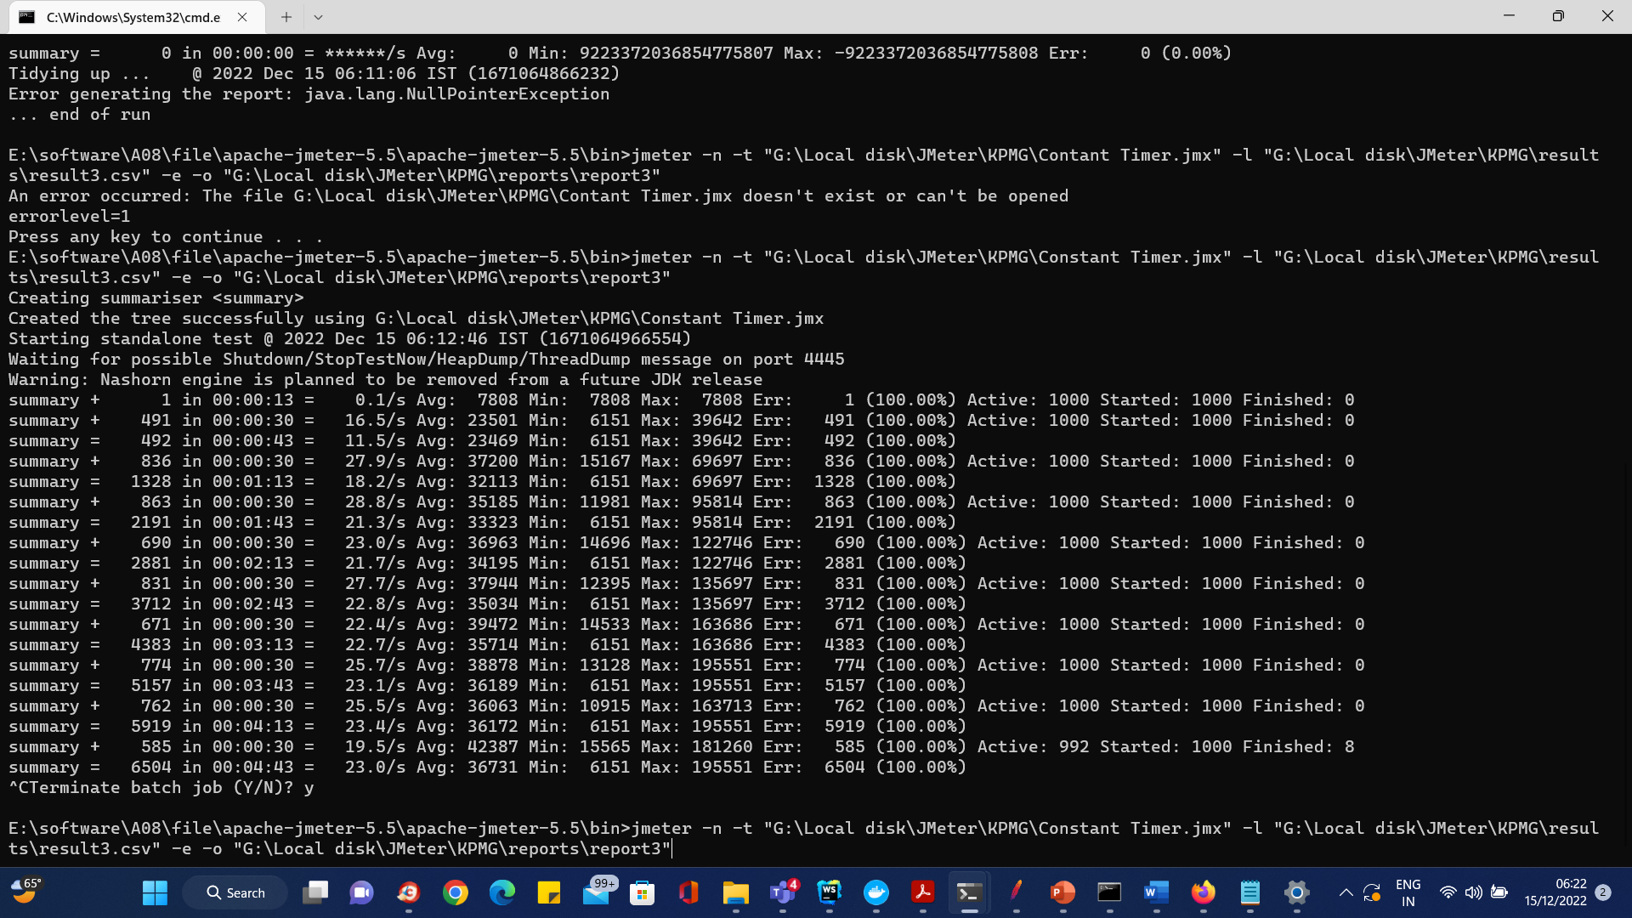
Jmeter html reports

Slide 88
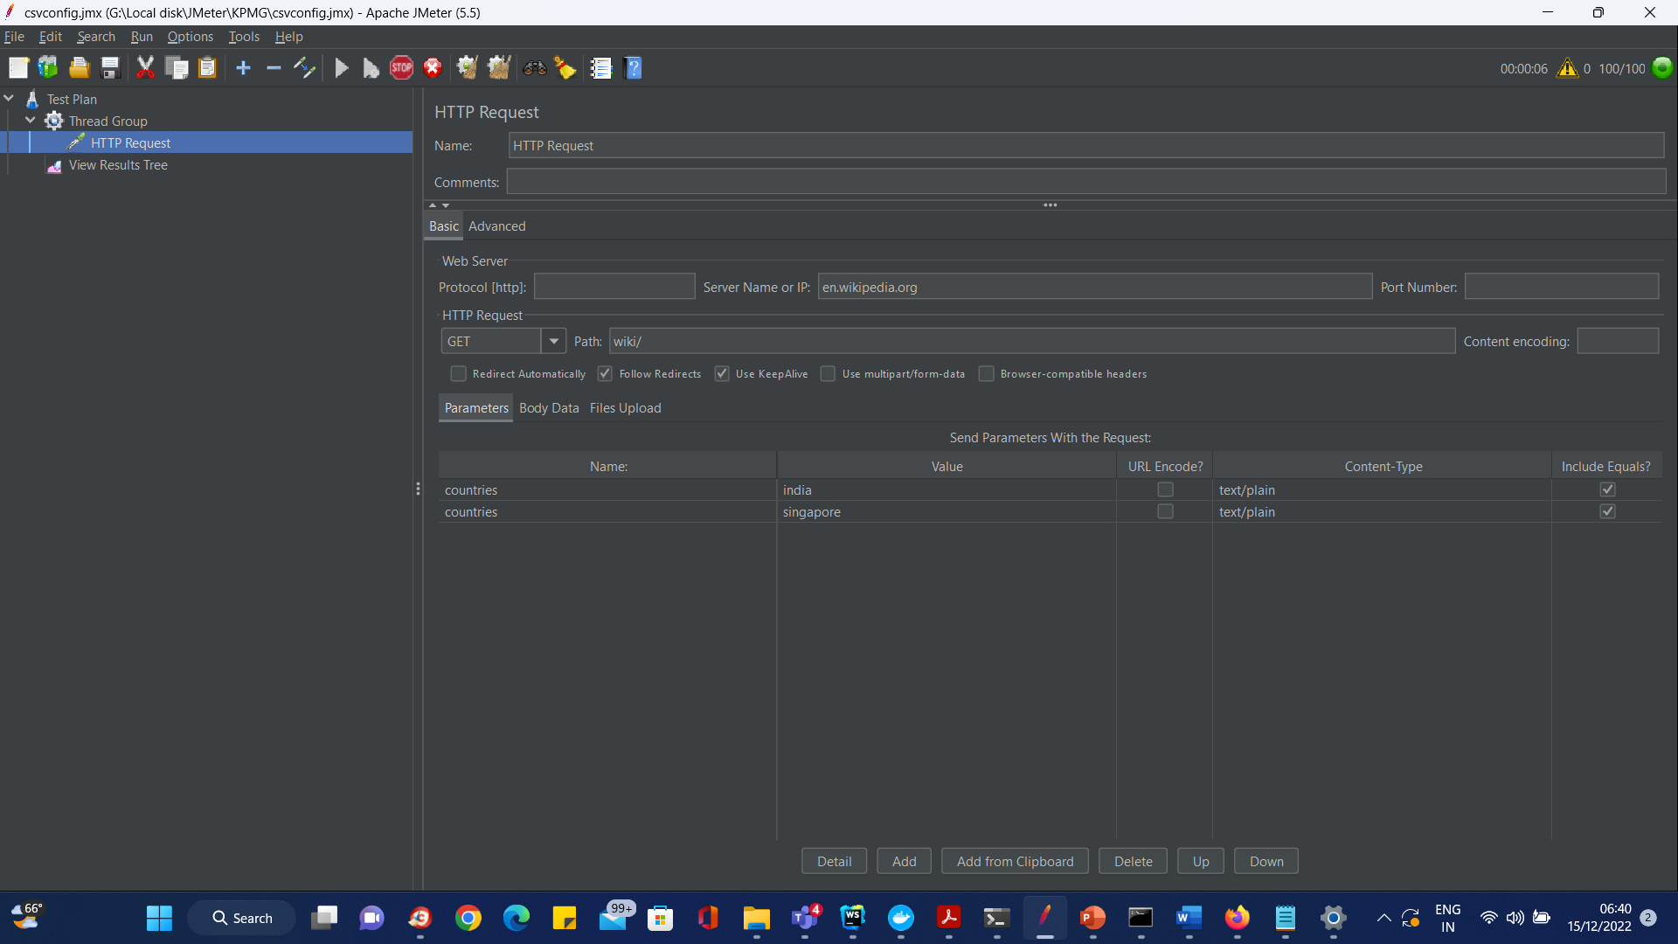
Parameterization in csv

Slide 89
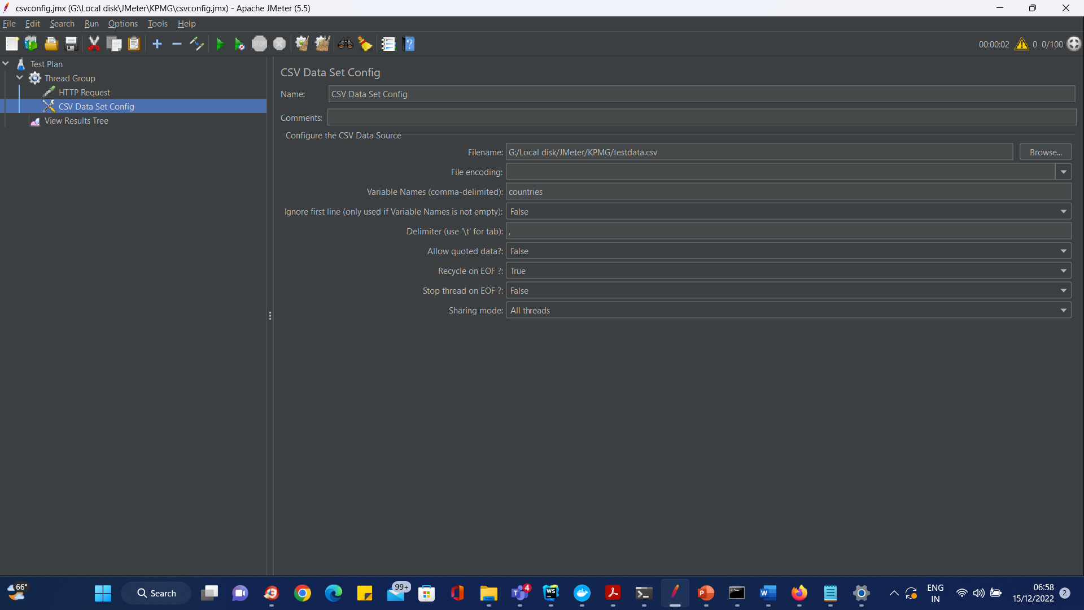
Parameterization in csv

Slide 90
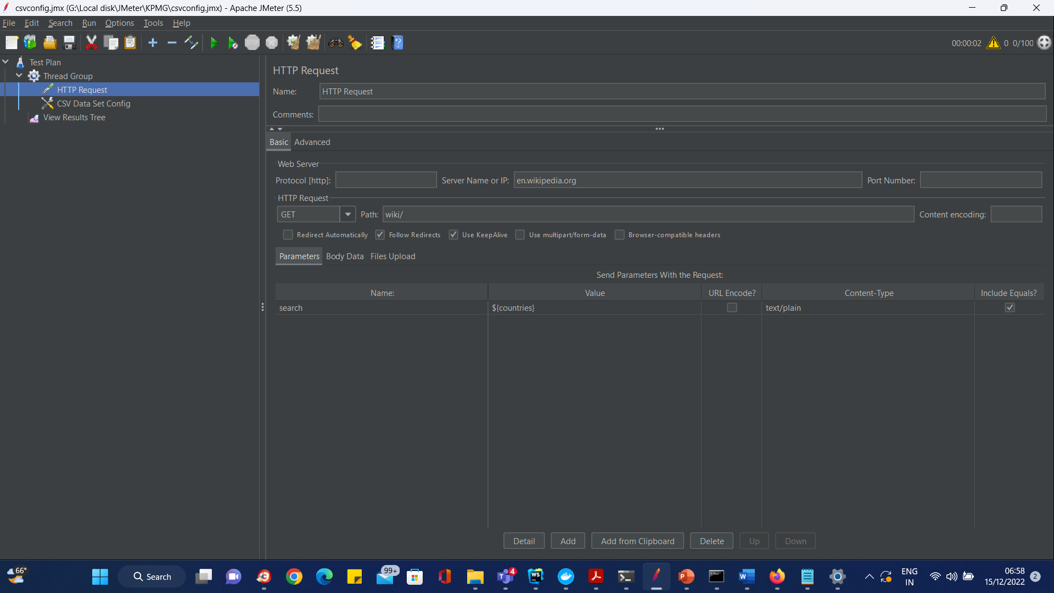
Parameterization in csv

Slide 91
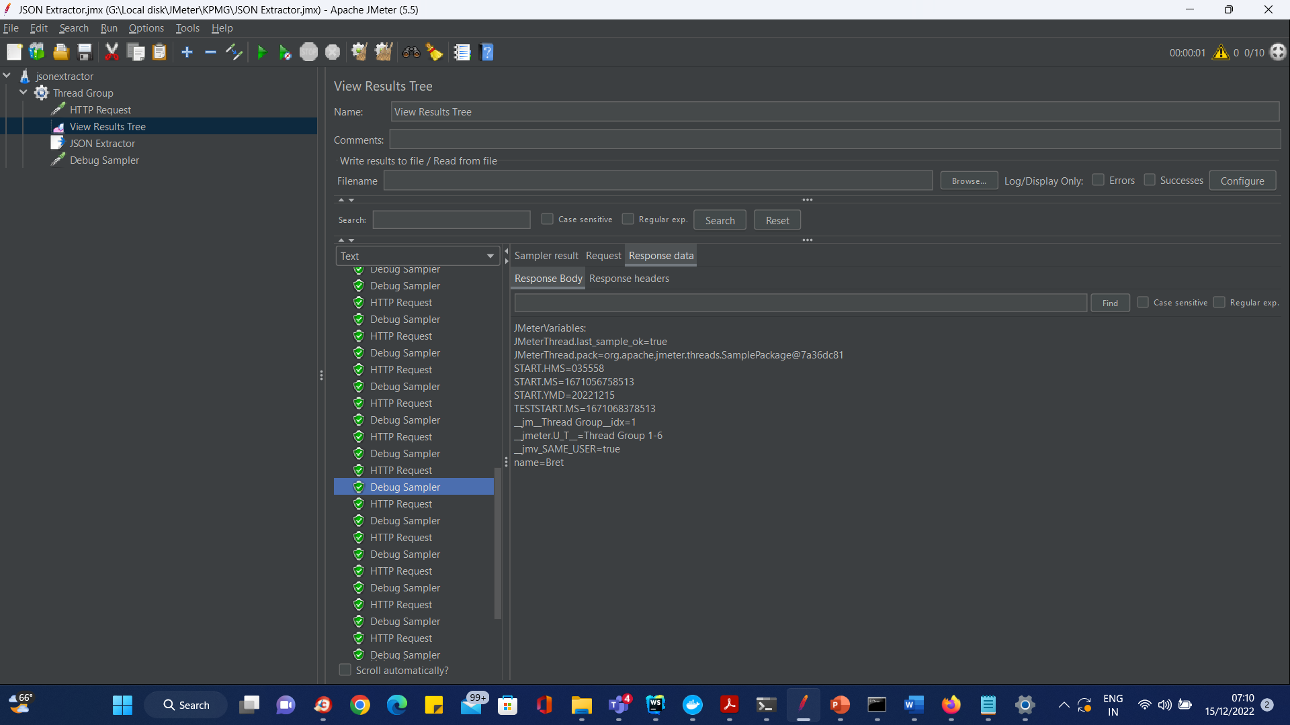
Json Extractor

Slide 92
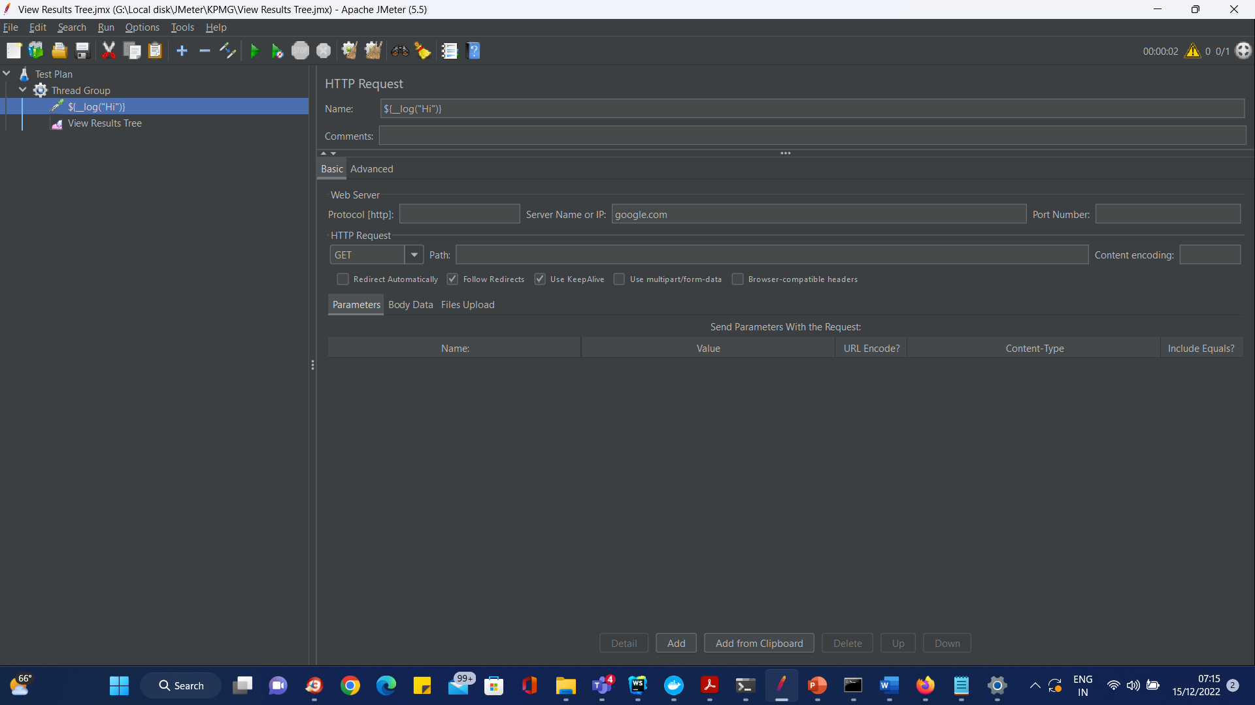
Functions and Variables

Slide 93
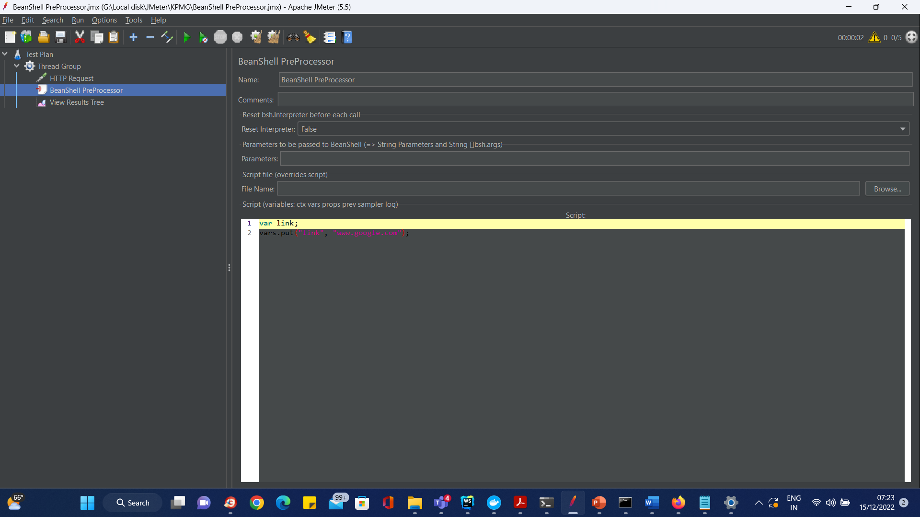
Bean Shell Preprocessor

Slide 94
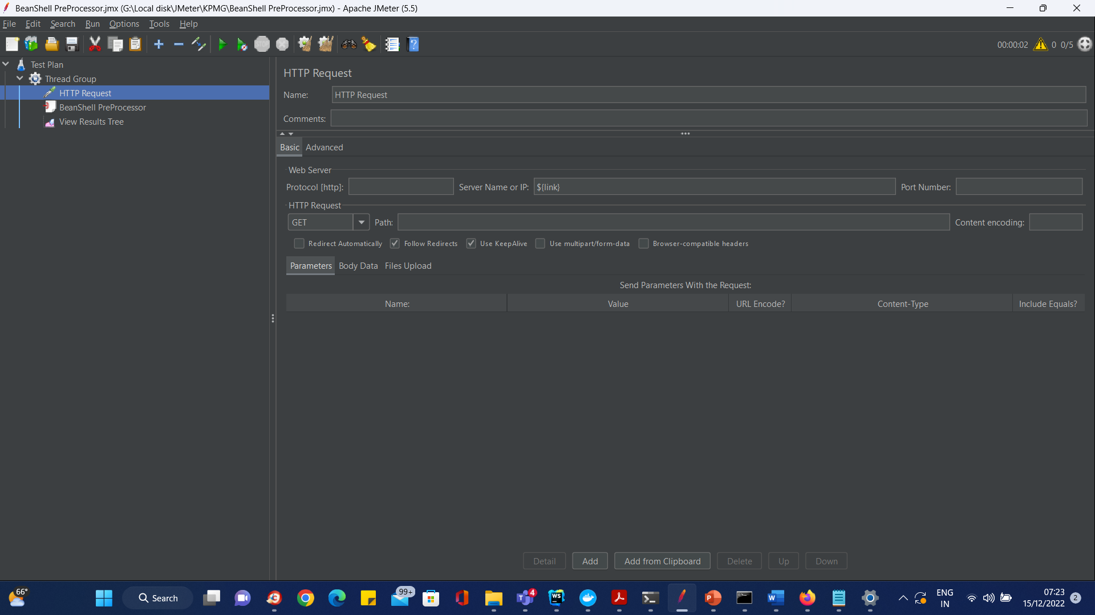
Bean Shell Preprocessor

Slide 95

Performance Testing using Jmeter

Slide 96

Performance Testing using Jmeter

Slide 97

Performance Testing using Jmeter

Slide 98

Create a Performance Test Plan in Jmeter

Slide 99

Add Thread Group

Slide 100

Add Thread Group

Slide 101

The Thread Count and The Loop Counts are different

Slide 102

The Thread Count and The Loop Counts are different

Slide 103


Adding JMeter elements

Slide 104

HTTP Request

Slide 105


HTTP Request

Slide 106

Adding Graph result

Slide 107

Run Test and get the test result

Slide 108
Run Test and get the test result
Black: The total number of current samples sent.
Blue: The current average of all samples sent.
Red: The current standard deviation.
Green: Throughput rate that represents the number of requests per minute the server handled

Slide 109

Run Test and get the test result

Slide 110

How to use Timers in Jmeter
Timers allow JMeter to delay between each request which a thread makes. Timer can solve the server overload problem.

Slide 111

Practical Demonstration of Timer Settings

Slide 112

Pre-condition
Step 1) Add Thread Group

Slide 113
Pre-condition
Step 2) Add JMeter elements
Add HTTP request default
Add HTTP request

Slide 114


Pre-condition
Step 3) Add Constant Timer

Slide 115

Pre-condition
Step 4) Add View Results in Table

Slide 116

Pre-condition
Step 4) Add View Results in Table

Slide 117

Pre-condition
Step 5) Run your test

Slide 118

How to use Assertions in JMeter
Response Assertion

Slide 119

How to use Assertions in JMeter
Duration Assertion

Slide 120
How to use Assertions in JMeter
The Size Assertion tests that each server response contains the expected number of byte in it.
You can specify that the size be equal to, greater than, less than, or not equal to a given number of bytes.
JMeter sends a user request to www.google.com and gets response packet with size less than expected byte 5000 bytes àtest case pass.
If else, test case failed.

Slide 121


How to use Assertions in JMeter
XML Assertion
HTML Assertion

Slide 122

Handson - Assertion

Slide 123

Handson - Assertion
Step 1) Add Response Assertion

Slide 124

Handson - Assertion
Step 1) Add Response Assertion

Slide 125

Handson - Assertion
Step 2) Add Pattern to test

Slide 126

Handson - Assertion
Step 2) Add Pattern to test

Slide 127

Handson - Assertion
Step 3) Add Assertion Results

Slide 128

Handson - Assertion
Step 3) Add Assertion Results

Slide 129

Handson - Assertion
Step 4) Run your test

Slide 130

Handson - Assertion
Step 4) Run your test

Slide 131

Handson - Assertion
Step 4) Run your test

Slide 132
How to use Processor in JMeter
Processor is used to modify the Samplers in their scope.
There are 2 Types of processors:
Pre-processor
Post-processor

Slide 133

Pre-processor:

Slide 134

Post-processor:

Slide 135


Processor-Hands on
Step 1) Add Thread Group
Step 2) Add JMeter elements
Add HTTP request default
Add HTTP request

Slide 136

Processor-Hands on
Step 3) Add Post-Processor Element

Slide 137

Processor-Hands on
Step 3) Add Post-Processor Element

Slide 138

Processor-Hands on
Config the HTTP Request

Slide 139

Processor-Hands on
Step 5) Add View Result Tree

Slide 140

Processor-Hands on
Step 6) Run Test

Slide 141

Processor-Hands on
Step 6) Add path

Slide 142

Processor-Hands on
Step 6) Run Test

Slide 143

How to perform Distributed Testing in JMeter
Master: the system running JMeter GUI, control each slave.
Slave: the system running jmeter-server, receive command from the master and send a request to server under test.
Target: the web server under test, get request from slaves.

Slide 144


Start your test
On the slave systems, go to jmeter/bin directory and execute file "jmeter-server.bat".

Slide 145

Start your test
On the master systems, go to /bin directory and edit file jmeter.properites, add IP slave machine as below

Slide 146

Start your test
Step 2) Run the test

Slide 147

Start your test
Step 3) Troubleshooting
If you are unable to run test form the above machine and see below error, simply ask owner of slave machine to run the jmeter-server.bat File.
There are some basic limitations for distributed testing. Here's list of the known items:
Server and all clients must be on the same subnet.
Distributed testing required target server to have large processing power.

Slide 148
Start your test
Step 3) Troubleshooting
There are some basic limitations for distributed testing. Here's list of the known items:
Server and all clients must be on the same subnet.
Distributed testing reThe target Server could be easilyoverloaded in case it gets too many requests by distributed JMeter tests.
A single JMeter can only handle a limited number of threads (100- 300 threads).
The distributed JMeter tests are complex, difficult for beginner to build.
quired target server to have large processing power.

Slide 149

Postprocessor

Slide 150
Questions

Slide 151
Module Summary
In this module we discussed
Overview of Maven
Maven archetypes
Maven life cycle phases
The pom.xml file
Creation of Java projects using Maven
Creation of war files

